Slide 1
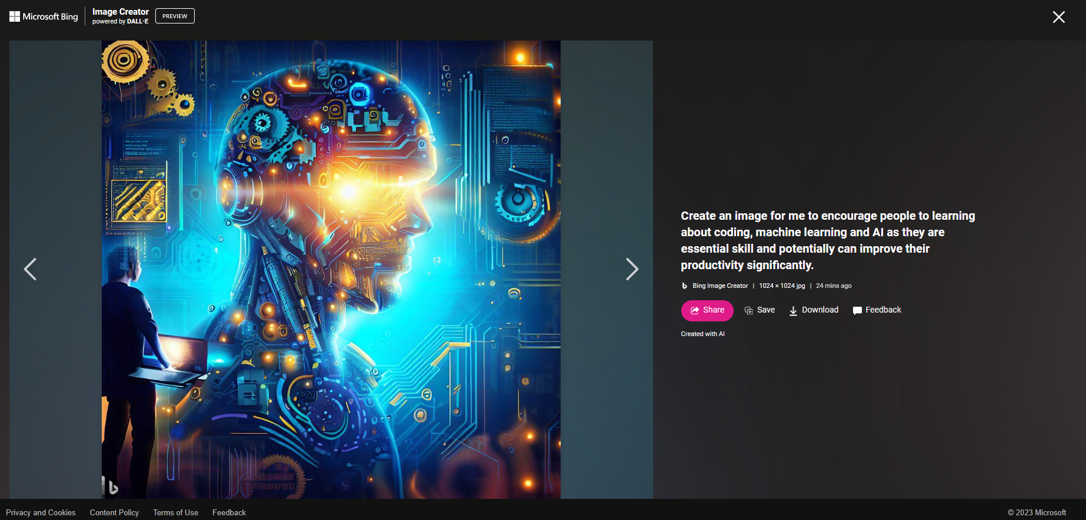
Topic 1: Data Analysis by Jupyter Notebook – Using K-mean Clustering to Analyse the Logging Data (By Wanjing Cai – 40 mins)
Topic 2: Elevate Your Skills: Simplifying AI and Coding for Impactful Advancements in Our Work (By Son Pham – 20 mins)

Slide 2
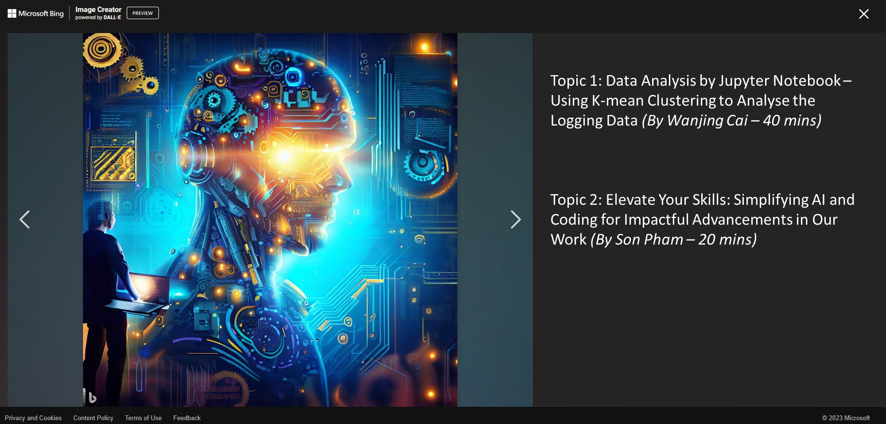

Slide 3
In the last 20mins, Son shares his hobby and opinion of coding and machine learning and recent advancement of Large Language Models (LLM) such as ChatGPT, and the potential to employ into our work.
We hope to have small community on learning, sharing and employing those digital technology in our daily life and work.
Fun story about the prediction/awareness/opinion of the recent AI:
Yann Lecun (Chief AI Scientist at Meta, ACM Turing Award Laureate) in an interview in Jan 2022: “I don't think we can train a machine to be intelligent purely from text. So for example I take an object, I put it on the table and I push the table. It's completely obvious to you that the object will be pushed with the table, right? Because it's sitting on it. There's no text in the world, I believe, that explains this. And so if you train a machine as powerful as it could be, you know your GPT 5000 or whatever it is, it's never going to learn about this. That information is just not present in any text
An ACM Turing Award Laureate is a recipient of the ACM A.M. Turing Award, which is an annual prize given by the Association for Computing Machinery (ACM) for contributions of lasting and major technical importance to computer sciencehttps://en.wikipedia.org/wiki/Turing_Award. It is generally recognized as the highest distinction in computer science and is colloquially known as the "Nobel Prize of Computing"

Slide 4
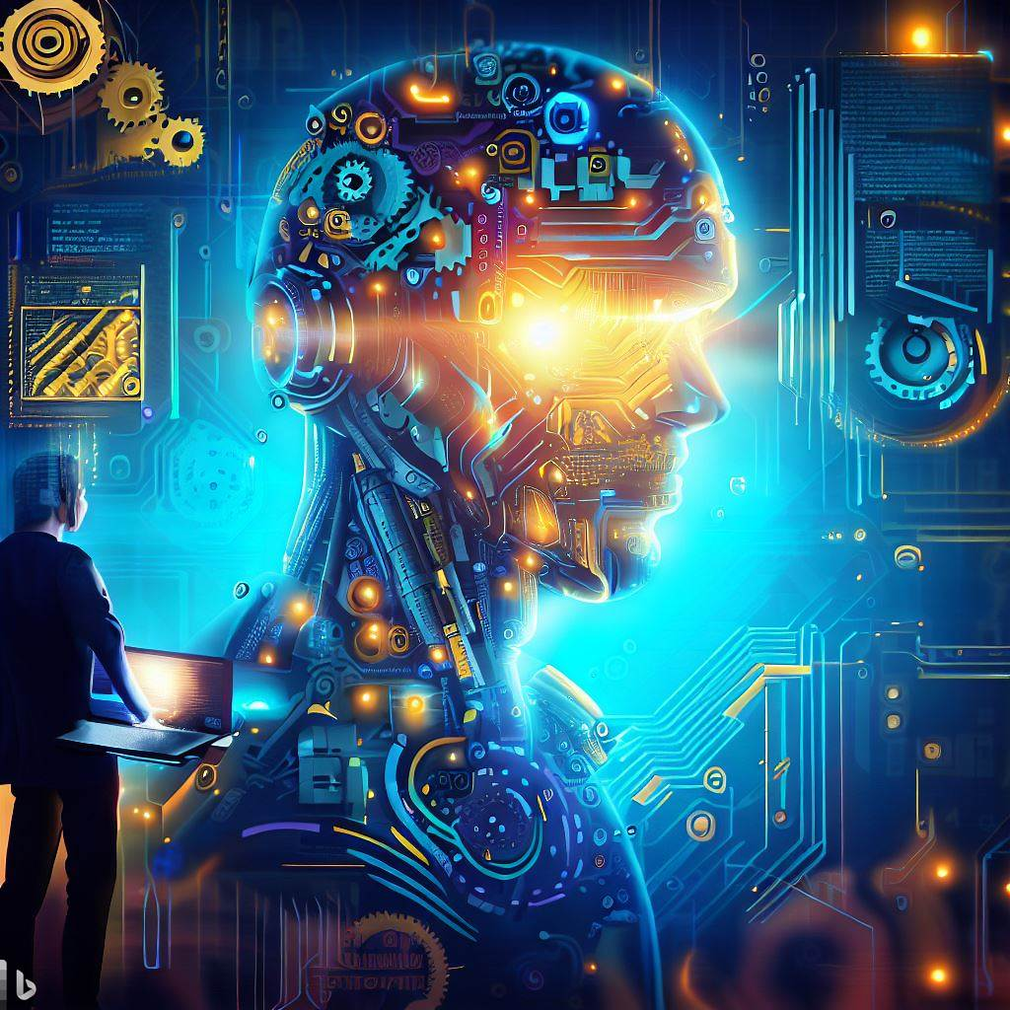

Slide 5
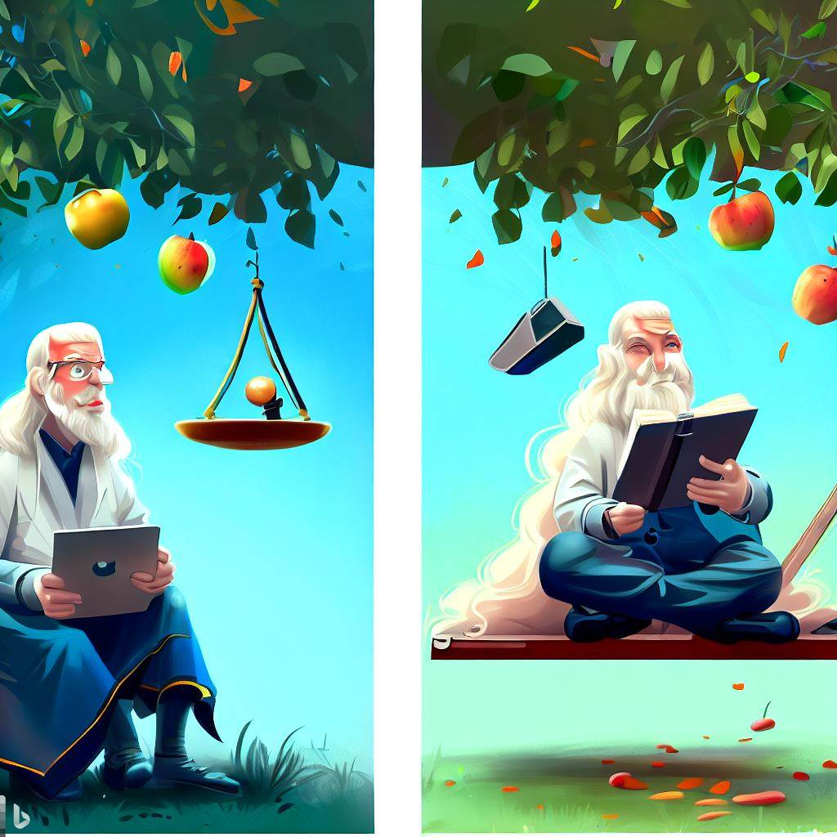
Empirical Approach:
Based on direct and indirect observation or experience
Relies on logical reasoning
Involves collection of quantifiable evidence
Used in scientific method
Example: Newton observed an apple falling and formulated laws of motion and universal gravitation
Machine Learning Approach:
Subset of artificial intelligence
Systems learn and improve from experience without explicit programming
Focuses on developing programs that learn from data
Example: Newton collects data on falling objects, feeds it into a machine learning algorithm, which predicts motion of other objects

Slide 6
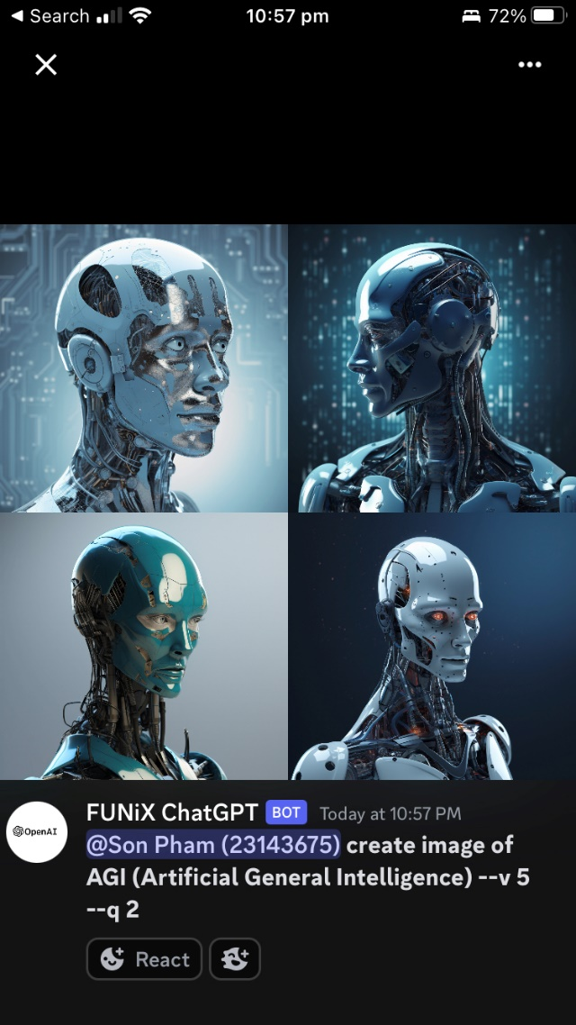
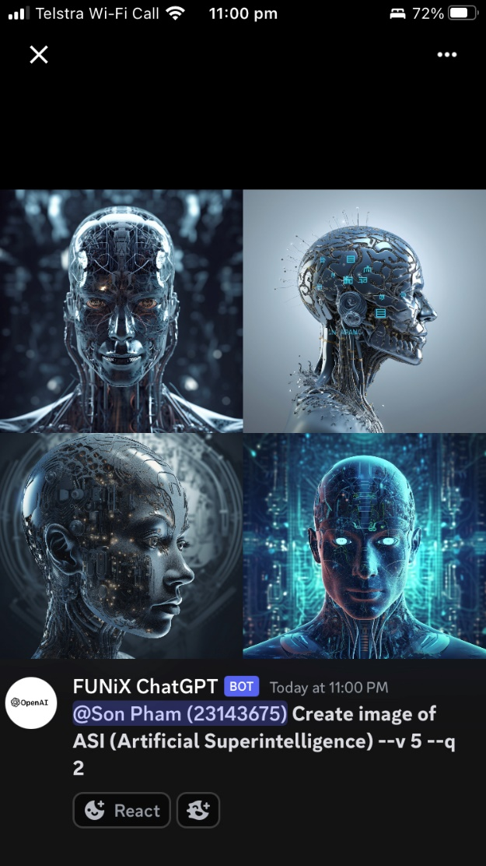
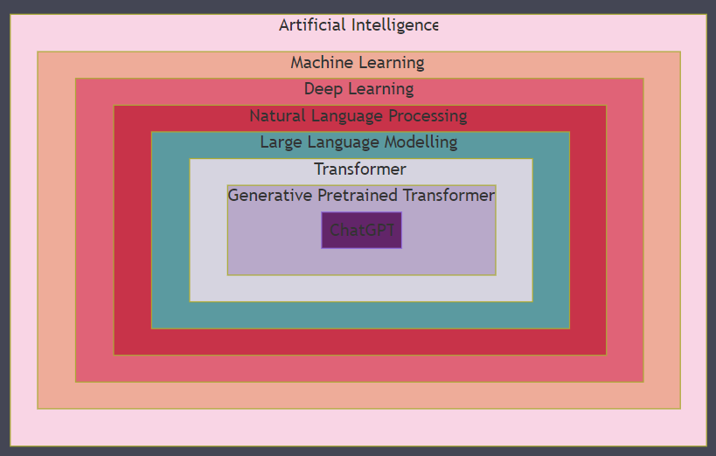
ChatGPT
Notes:
AGI stands for Artificial General Intelligence, which is a type of hypothetical intelligent agent that can learn to accomplish any intellectual task that human beings or other animals can perform https://en.wikipedia.org/wiki/Artificial_general_intelligence. AGI is also known as 'true' AI, 'strong AI', or 'full AI' https://www.linkedin.com/pulse/ai-vs-agi-sachin-sharma. AGI is different from AI or weak AI (or narrow AI), which can only perform specific tasks that are already programmed https://www.linkedin.com/pulse/ai-vs-agi-sachin-sharma https://en.wikipedia.org/wiki/Artificial_general_intelligence. AGI is a primary goal of some artificial intelligence research and companies such as OpenAI, DeepMind, and Anthropic https://en.wikipedia.org/wiki/Artificial_general_intelligence. AGI is a common topic in science fiction and futures studies https://en.wikipedia.org/wiki/Artificial_general_intelligence.
The higher level than AGI is Artificial Superintelligence (ASI), which is a type of hypothetical intelligent agent that can surpass human intelligence and capabilities in all domains https://www.techtarget.com/searchenterpriseai/definition/artificial-general-intelligence-AGI. ASI is also known as 'super AI' or 'godlike AI' https://www.techtarget.com/searchenterpriseai/definition/artificial-general-intelligence-AGI. ASI is the ultimate goal of some artificial intelligence research and companies such as such as OpenAI, DeepMind, and Anthropic https://www.techtarget.com/searchenterpriseai/definition/artificial-general-intelligence-AGI. ASI is a common topic in science fiction and futures studies https://www.techtarget.com/searchenterpriseai/definition/artificial-general-intelligence-AGI.

Slide 7
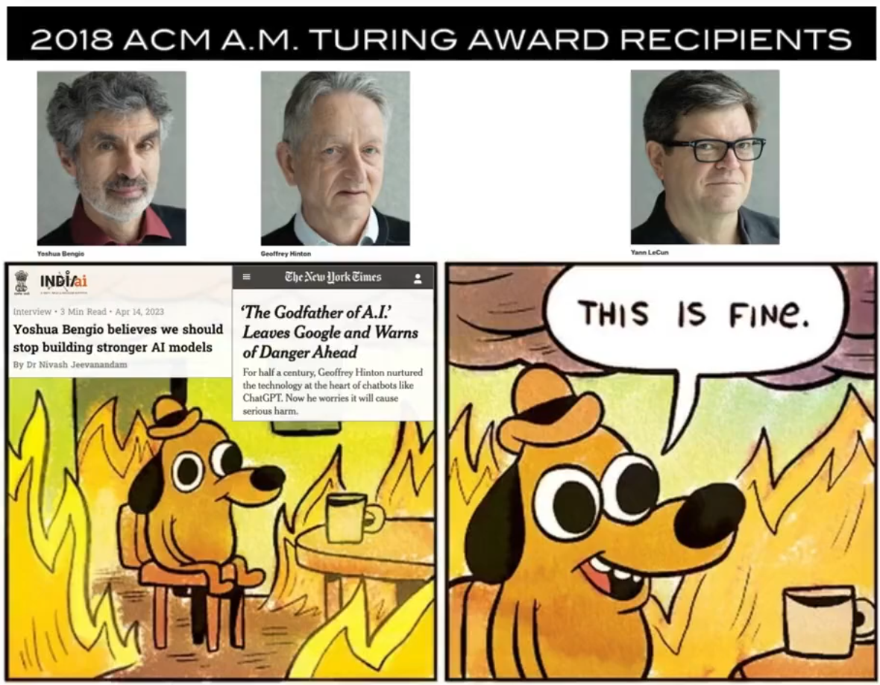

Slide 8
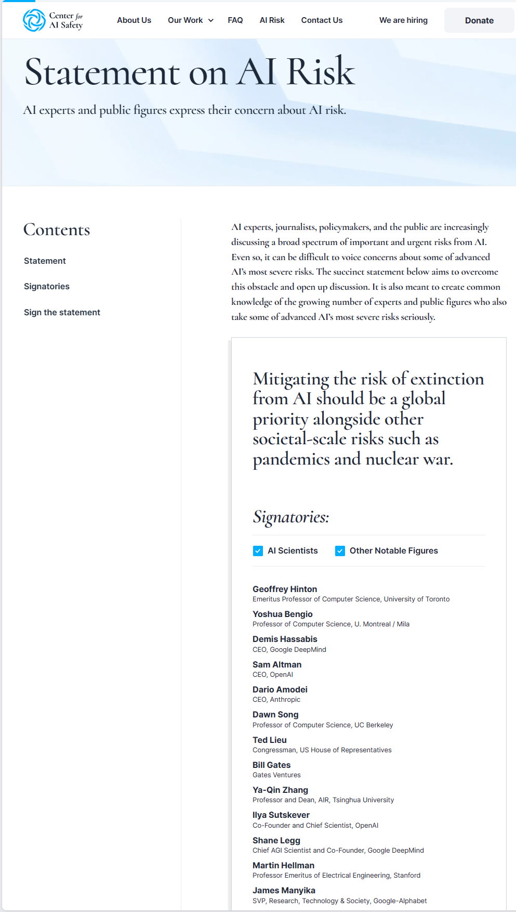
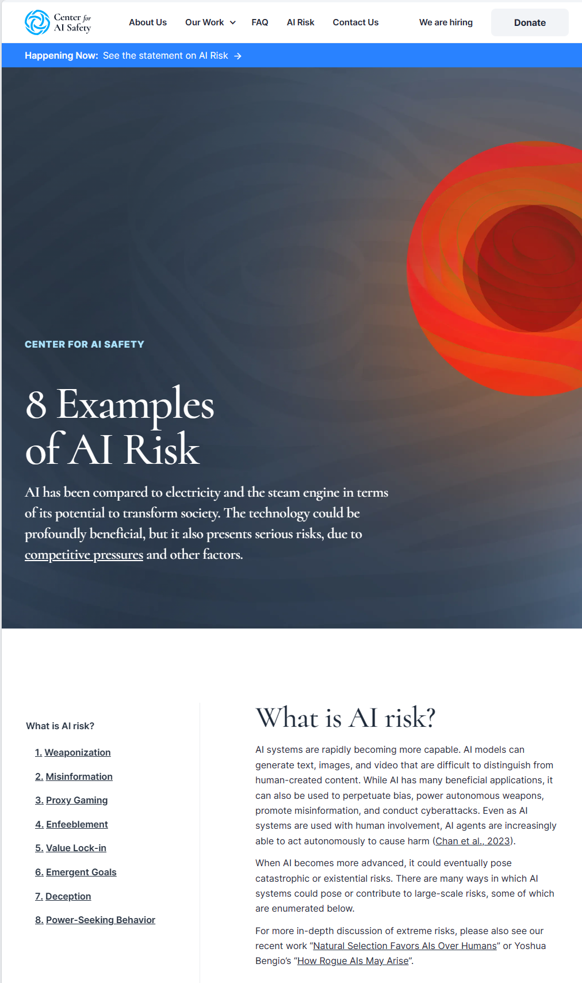

Slide 9
